Slide 1
期末复习

Slide 2
期末
选择题：20题，每题1.5分，共30分
填空题：10题，每题2分，共20分
Python程序题： 5题，每题3分，共15分
Django程序设计： 共35分

Slide 3
Python(01,02,03,04)

Slide 4
List and tuple
What is list?
What is tuple?
What is different between two of them?

Slide 5
Dictionary and flow control

Slide 6
Function Arguments
Required arguments
Keyword arguments
Default arguments
Variable-length arguments

Slide 7
File I/O
Python provides basic functions and methods necessary to manipulate files by default. You can do most of the file manipulation using a file object.

Slide 8
The open Function
Before you can read or write a file, you have to open it using Python‘s built-in open() function. This function creates a file object.
file = open(file_name, [access_mode] ,[buffering])

Slide 9
05.Django Overview
江琳

Slide 10
Django MVT pattern
Models: manage(add, modify, delete) records in database
View: A view is a request handler function, which receives HTTP requests and returns HTTP responses.
Template: is a text file defining the structure or layou

Slide 11
Django MVT pattern
Model
Read/Write Database
HTTP Request
Url
Forward Request
View
HTTP Response
Template

Slide 12
Django Environment

Slide 13

Django setup – step 1
Check Python
Being a Python web framework, Django require Python
Before install Django, check the version of Python
$ python –V
Python 3.6.1

Slide 14

Django setup – step 2
Install Django
pip install django // install the newest version
If want to install previous version
pip install django==1.10.7
$ pip install django
# install previous version
$ pip install django==1.10.7

Slide 15
Django setup – step 3
Verify
Open terminal and type below command:
$ python
>>> import django
>>> print(django.get_version())
1.11.4

Slide 16
Let’s start a Project!
Creating Django project
Before creating, cd to the directory where you want to store your code
django-admin startproject <project_name>
# create a django project named library
$ django-admin startproject library

Slide 17
Let’s start a Project!
library
library
__init__.py
settings.py
urls.py
wsgi.py
manage.py

Slide 18
What is created?
__init__.py treat this folder as package, just for python
settings.py contains all the website settings, such as database, static file and so on.
urls.py defines the site url-to-view mapping.
wsgi.py is used to help your Django application communicate with the web server.

Slide 19
What is created?
manage.py is kind of your project local django-admin for interacting with your project via command line.
To get full list of command:
python manage.py help

Slide 20
virtualenv
Virtualenv is a tool to create isolated Python environments.
Virtualenv creates a folder which contains all necessary executables packages that a Python project would need.

Slide 21
virtualenv -- install
Install
pip install virtualenv
Test your installation
virtualenv --version
$ virtualenv --version
15.1.0

Slide 22
virtualenv -- create
Create a virtual environment for a project
$ cd project_folder
$ virualenv <env_name>
Using the Python interpreter of your choice
$ virtualenv –p python3 <env_name>
$ cd <project_folder>
$ virtualenv env
# define python version
$ virtualenv –p python2.7 env

Slide 23
virtualenv -- activate
To begin using the virtual environment, it needs to be activated.
# OS or Linux
$ source env/bin/activate
# Windows
$ env\Scripts\activate

Slide 24
virtualenv -- deactivate
If you are done working in the virtual environment for the moment, you can deactivate
(env) $ deactivate
$

Slide 25
verify
Let’s verify your Django project works.
$ cd library
$ env\Scripts\activate
(env)$ python manage.py runserver
Now, open the web page at http://127.0.0.1:8000
By default, the runserver command starts the development server on the internal IP at port 8000.

Slide 26
Changing the port
If you want to change the server’s port, pass it as a command-line argument. For instance, this command starts the server on port 8080:
(env)$ python manage.py runserver 8080

Slide 27
Changing the port
If you want to change the server’s IP, pass it along with the port.
(env)$ python manage.py runserver 0.0.0.0:8000
Open settings.py
ALLOWED_HOSTS = ['*']

Slide 28
06.DJANGO MODEL
江琳

Slide 29
Database ENGINE
sqlite
django.db.backends.sqlite3
PostgreSQL
MySQL
django.db.backends.mysql
Oracle
django.db.backends.oracle
django.db.backends.postgresql

Slide 30

Create an Application
Create an app named books
$ cd <project folder>
$ python manage.py startapp books

Slide 31
Philosophy
A model is the single, definitive source of truth about your data.
It contains the essential fields and behaviors of the data you are storing.

Slide 32
Model -- Publisher
from django.db import models
class Publisher(models.Model):
name = models.CharField(max_length=200)
address = models.CharField(max_length=200, null=True, blank=True)
Each model is represented by a class that subclasses django.db.models.Model
Each model has a number of class variables, each of which represents a database fields in the model.

Slide 33
Field
Each field is represented by an instance of a Field class:
CharField for character fields
DateTimeField for datetimes
IntegerField for integer
TextField for a large text field
BooleanField for a true or false field
ImageField for upload a image
https://docs.djangoproject.com/en/1.11/ref/models/fields/

Slide 34
Model -- Book
class Book(models.Model):
name = models.CharField(max_length=200)
pub_year = models.IntegerField(default=0)
cover = models.ImageField(upload_to='cover/%Y/%m/%d/')
serial_num = models.CharField(max_length=100)
available = models.BooleanField(default=True)
author = models.ForeignKey(Author)
publisher = models.ForeignKey(Publisher)
category = models.ForeignKey(Category)
intro = models.TextField(null=True, blank=True)
purchase_at = models.DateField(auto_now_add=True)

Slide 35
Activating models
Runing makemigrations:
$ python manage.py makemigrations books
Telling Django that you have make some changes to your models and that you would like the changes to be stored as a migrations

Slide 36
migrate
Running migrate to create this model tables in your database:
python manage.py migrate
The migrate command takes all the migrations that haven’t been applied and runs them against your database

Slide 37
07.DJANGO ADMIN
江琳

Slide 38
Play with dbshell
(env) $ python manage.py dbshell
SQLite version 3.16.0 2016-11-04 19:09:39Enter ".help" for usage hints.
sqlite> .table
auth_group books_book
auth_group_permissions books_category
auth_permission books_publisher
auth_user django_admin_log
auth_user_groups django_content_type auth_user_user_permissions django_migrations
books_author django_session
auth_user is the default user model

Slide 39
Play with dbshell
The command python manage.py dbshell access the database that define in settings.py.
If the database is PostgreSQL or MySQL, password will be required.
We can execute custom SQL command under this mode.

Slide 40

Step 1: custom user model
from django.contrib.auth.models import AbstractUser
class User(AbstractUser):
nickname = models.CharField(max_length=100)
AbstractUser is a full User model, compete with fields, as an abstract class so that you can inherit from it and add your own profile fields and methods.

Slide 41
Creating superuser
First of all, we need to create a user who can login to the admin site.
(env) $ python manage.py createsuperuser
Username: admin
Email address: admin@admin.com
Password:
Password (again):
Superuser created successfully.

Slide 42
Admin site
open the accounts/admin.py and code below:
from django.contrib import admin
from .models import User
admin.site.register(User)

Slide 43
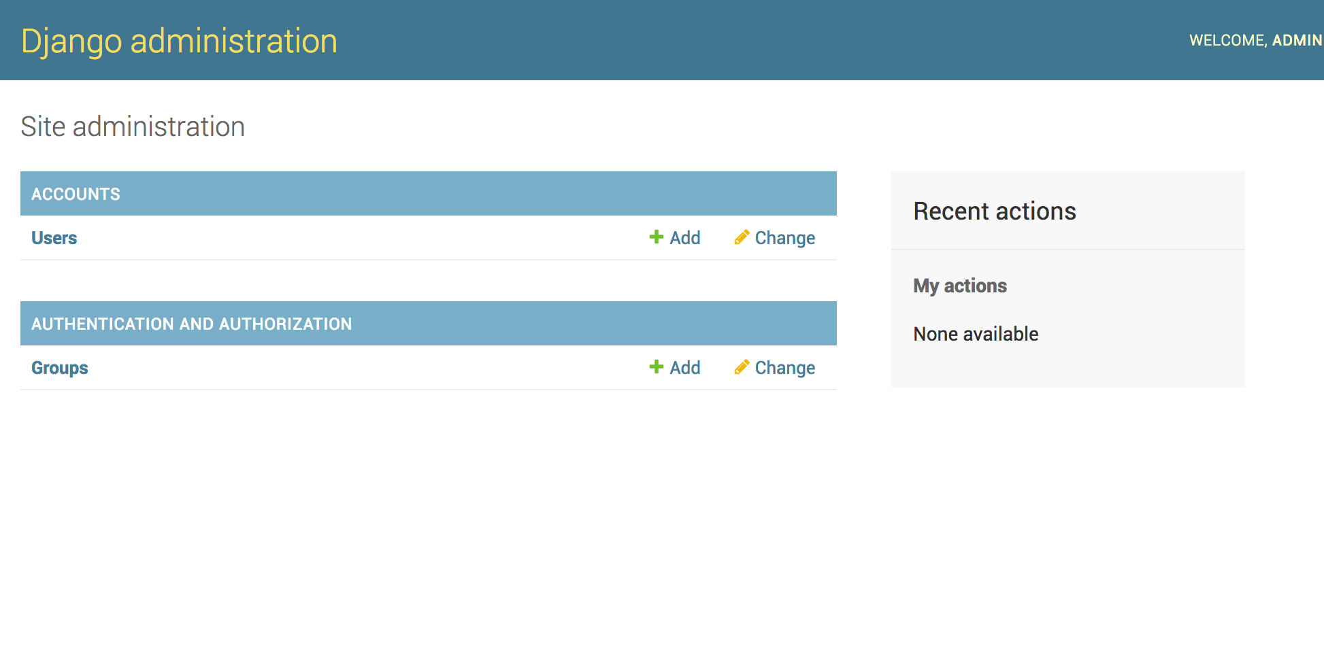
Admin site
Now, we can add new user and change existing user in admin site

Slide 44
Admin site
Open books/admin.py then code below:
from django.contrib import admin
from .models import Publisher, Author, Category, Book
admin.site.register(Publisher)
admin.site.register(Author)
admin.site.register(Category)
admin.site.register(Book)

Slide 45

Modeladmin
The ModelAdmin class is the representation of a model in the admin interface.
from django.contrib import admin
from .models import User
class UserAdmin(admin.ModelAdmin):
pass
admin.site.register(User, UserAdmin)

Slide 46

Modeladmin
from django.contrib import admin
from .models import User
class UserAdmin(admin.ModelAdmin):
fields = ('username', 'is_superuser', 'password')
list_display = ('username', 'is_superuser')
admin.site.register(User, UserAdmin)

Slide 47
Modeladmin
fields option to make simple layout changes in the forms on the “add” and “change” pages
list_display to control which fields are displayed on the change list page of the admin.

Slide 48
The register decorator
from django.contrib import admin
from .models import User
@admin.register(User)
class UserAdmin(admin.ModelAdmin):
fields = ('username', 'is_superuser', 'password')
list_display = ('username', 'is_superuser')
The register decorator can instead of admin.site.reigster

Slide 49
08.Django QuerySet
江琳

Slide 50
All need to review

Slide 51
09.DJANGO VIEWS AND TEPLATES
江琳

Slide 52
Philosophy of view
A view function, or “view” for short, is simply a Python function that takes a web request and returns a web response.
This response can be the HTML contents of a Web page, or a redirect, or a 404 error, or an XML document, or an image, etc.

Slide 53
Views.py
In Django, views have to be created in the app views.py file.
books
migrations
__init__.py
__init__.py
admin.py
apps.py
models.py
tests.py
views.py

Slide 54
Simple view
Coding in books/views.py
from django.http import HttpResponse
def home(request):
return HttpResponse('Welcome to Libaray!')
In this view, we use HttpResponse to render the HTML .
To see this view as a page we just need to map it to a URL

Slide 55
url mapping
We access to view via a URL. Django has his own way for URL mapping and it's done by editing your project url.py file
library
__init__.py
settings.py
urls.py
wsgi.py

Slide 56
url
from django.conf.urls import include, url
from books.views import home
urlpatterns = [
url(r'^admin/', include(admin.site.urls)),
url(r'^$', home, name='home'),
]
When a user makes a request for a page on your web app, Django controller takes over to look for the corresponding view via the url.py file.
If not fount, a 404 not fount error is returned

Slide 57
Philosophy of template
Django makes it possible to separate python and HTML, the python goes in views and HTML goes in templates. To link the two, Django relies on the render function and the Django Template language.

Slide 58
Template
BACKEND: The template backend to use. The built-in template backends are:
'django.template.backends.django.DjangoTemplates'
'django.template.backends.jinja2.Jinja2’
DIRS: Directories where the engine should look for template source files, in search order

Slide 59
10.DJANGO generic display view
江琳

Slide 60
Generic display view
Generic display views are designed to display data. On many projects they are typically the most commonly used views.
ListView
DetailView

Slide 61
DetailVIew
class django.views.generic.detail.DetailView
DetailView uses to get and return a object from a model.

Slide 62

DetailVIew
Let’s modify the BookDetail view using DetailView
class BookDetail(DetailView): model = Book template_name = 'detail.html’
# in url.py url(r'^book/(?P<pk>\d+)/', BookDetail.as_view(), name='book_detail'),

Slide 63
listview
Let’s write a page to list of books using ListView
class BookList(ListView): model = Book template_name = 'list.html'

Slide 64
11.DJANGO basic view
江琳

Slide 65
Philosophy
The following three classes provide much of the functionality needed to create Django views.
View
TemplateView
RedirectView

Slide 66
view
class django.views.generic.base.View
The master class-based base view.
All other class-based views inherit from this base class. It isn’t strictly a generic view and thus can also be imported from django.views.

Slide 67
templateview
Renders a given template, with the context containing parameters captured in the URL.
Method flowchart
dispatch()
http_method_not_allowed()
get_context_data()

Slide 68
redirectview
Redirects to a given URL.If the given URL is None, Django will return an HttpResponseGone (410).
Method Flowchart:
dispatch()
http_method_not_allowed()
get_redirect_url()

Slide 69
12.DJANGO generic Editing view
江琳

Slide 70
Philosophy
The edting views are used to provide a foundation for editing content.
django.views.generic.edit.CreateView
django.views.generic.edit.UpdateView
django.views.generic.edit.DeleteView

Slide 71
createview
A view that displays a form for creating an object, redisplaying the form with validation errors (if there are any) and saving the object.
django.views.generic.edit.CreateView

Slide 72
updateview
A view that displays a form for editing an existing object, redisplaying the form with validation errors (if there are any) and saving changes to the object. This uses a form automatically generated from the object’s model class.
class django.views.generic.edit.UpdateView

Slide 73
deleteview
A view that displays a confirmation page and deletes an existing object. The given object will only be deleted if the request method is POST. If this view is fetched via GET, it will display a confirmation page that should contain a form that POSTs to the same URL.
class django.views.generic.edit.DeleteView

Slide 74
14.Django Template
江琳

Slide 75
Build-in template filter
https://docs.djangoproject.com/en/2.0/ref/templates/builtins/#built-in-filter-reference

Slide 76

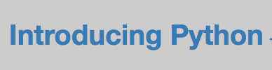
title
Converts a string into titlecase by making words start with an uppercase character and the remaining characters lowercase.
{{ obj.name }}
{{ obj.name|title }}

Slide 77

lower
Converts a string into all lowercase.
{{ obj.name }}
{{ obj.name|lower }}

Slide 78

upper
Converts a string into all uppercase.
{{ obj.name|upper }}

Slide 79
truncatechars
Truncates a string if it is longer than the specified number of characters. Truncated strings will end with a translatable ellipsis sequence (“…”).

Slide 80


truncatechars
{{ obj.intro|truncatechars:'60' }}

Slide 81

truncatewords
Truncates a string after a certain number of words.
{{ obj.intro|truncatewords:'6' }}

Slide 82
length
Returns the length of the value. This works for both strings and lists.
{{ object_list|length }}

Slide 83

yesno
Maps values for True, False, and (optionally) None, to the strings “yes”, “no”, “maybe”, or a custom mapping passed as a comma-separated list, and returns one of those strings according to the value
{{ value|yesno:"yeah,no,maybe" }}

Slide 84
Questions?

